Slide 1

HOPE FOUNDATION’S
INTERNATIONAL INSTITUTE OF INFORMATION TECHNOLOGY , (I2IT)
http://www.isquareit.edu.in
+91 20 22933441 / 2

Slide 2
Fake News Detection with Data mining
GROUP ID: G8
1. Sejal Kalyankar (BC040)
2. Tejal Jadhav (BC064)
3.Shraddha Jagtap (BC072)
Guided by:
Prof. Kimi Ramteke

Slide 3
CONTENTS
Introduction
Title Knowledge
Motivation
Objectives
Advantages and Disadvantages
Software Requirements
Hardware Requirements
Conclusion

Slide 4
Introduction
Fake news detection is the task of detecting forms of news consisting of deliberate disinformation spread via traditional news media (print and broadcast) or online social media (Source: Adapted from Wikipedia).
As an increasing amount of our lives is spend interacting online through social media platforms, more and more people tend to seek out and consume news from social media rather than traditional news organizations.
The reasons for this change in consumption behaviors are inherent in the nature of these social media platforms:
(1) it is often more timely and less expensive to consume news on social media compared with traditional news media, such as newspapers or television; and
(2) it is easier to further share, comment on, and discuss the news with friends or other readers on social media.

Slide 5
How it works?
Manual fake news detection often involves all the techniques and procedures a person can use to verify the news.
It could involve visiting fact checking sites. It could be crowdsourcing real news to compare with unverified news. But, the amount of data generated online daily is overwhelming.
With the help of news characterization we can detect the news is fake or real.
The upcoming technique useful to detecting fake news.

Slide 6
Fake News Detector is a feature added by Flock.
FLOCK-a new generation messaging and collaborative platform.
Whenever links are being sent to each while chatting, FND algorithm gets activates. It checks the content of links to their databases of websites computed according to rankings.
There are two to three algorithms for detection of fake news:
CNN (Convolutionary Neural Network)
Long Short Term memory
Logistic regression

Slide 7
Title knowledge
Fake news detection is the task of detecting forms of news consisting of deliberate disinformation spread via traditional news media.
Nowadays very fake news are reveals at social media platforms . Hence the people follow that news but they are aware of reality’s. And happening the mis-issues on it.
The issue of fake news are a major concern amongst scholars from various backgrounds. For instance, some authors have observe that fake news is no longer a preserve of the marketing and public relations departments .

Slide 8
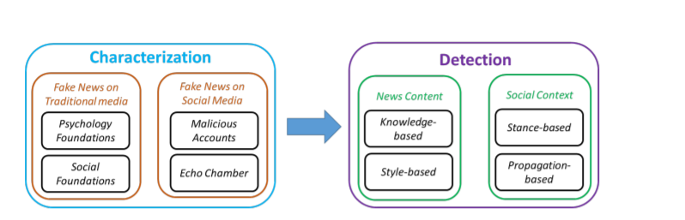
Fake news detection from characterization to detection process:

Slide 9
Motivation
The challenge for fake news detection comes with the democratization of news sources, and how easy modern technology makes sharing news articles in the age of social media.
There are many fake news stories and made up headlines all over social media. Social medias such as Twitter, Facebook, or Instagram are all major medias that are most common to the age group of people who read news articles and are drawn to fake news sites.

Slide 10
Objectives
The main objective is to detect the fake news, which is a classic text classification problem with a straight forward proposition. It is needed to build a model that can differentiate between “Real” news and “Fake” news.
The extensive spread of fake news has the potential for extremely negative impacts on individuals and society. Therefore, fake news detection on social media has recently become an emerging research that is attracting tremendous attention. Fake news detection on social media presents unique characteristics and challenges that make existing detection algorithms from traditional news media ineffective or not applicable.

Slide 11
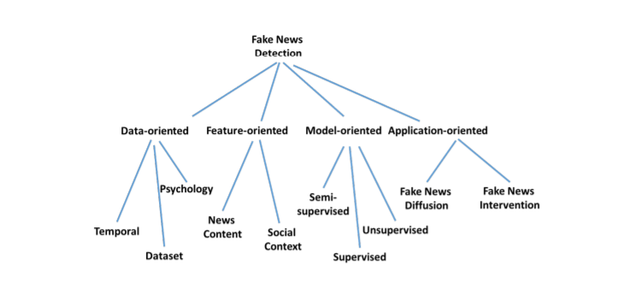
Future direction & open issues for Fake news detection on social media.

Slide 12
Advantages and disadvantages Of fake news:
Advantages
Disadvantages
Advertisers take the Advantages of Fake News
Influencers with millions of fan following get money from their sponsors Social media influencers need daily content to draw their followers’ attention.
Political Warfare
Fun and Entertainment
Change in Public Opinion
To spread misinformation across borders.
False Perception
Fake News may lead to Social Unrest
Rumors leading to mob attacks
Accuracy of fake news detection is less

Slide 13
Requirements:
Software Requirements
Anaconda
Python 3.6

Slide 14
Conclusion
Fake news are false stories in order create influence the public on a political or sociological issue with the assistance of social media, internet, and established news sources.
The three main causes are; the social media and internet impact, the rise of unreliable news sources and fall of authoritative news outlets, and lastly the anonymity behind the creation of fake news and misinformation.
With the increasing popularity of social media, more and more people consume news from social media instead of traditional news media. However, social media are also use to spread fake news, which has strong negative impacts on individual users and broader society.
we explore the fake news problem by reviewing existing literature in two phases: characterization and detection. In the characterization phase, we introduce the basic concepts and principles of fake news in both traditional media and social media. In the detection phase, we review existing fake news detection approaches from a data mining perspective, including feature extraction and model construction.

Slide 15
Thank you!

